Slide 1
Team
Challengers

Slide 2
Table of contents
01.
The project
02.
Project goals
03.
Our team

Slide 3
About the project
To create an interactable periotic table based on C++

Slide 4
Project goals
Goal 1
Goal 2
Goal 3
Form and create a team
Come up with an idea and distribute the tasks evenly between the team
Complete and finish the project

Slide 5
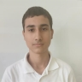
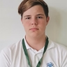
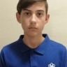
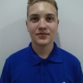
Out team
Valentin Lazarov
Stiliyan Ivanov
Valentin Pendashev
Alexander Sivkov
Scrum Trainer
Backend Developer
Backend Developer
Designer

Slide 6






Software we used
Word
PowerPoint
Excel
Teams
GitHub
Visual studio

Slide 7
Lets continue to the app

